Slide 1




EDA Project on Mobile Price Classification
-By:
GURUPRASADREDDY J
Data Science
Under the guidance of:
RAPAKA MANOJKUMAR
Data science trainer

Slide 2


Introduction to Mobile Price Classification
This project is based on the Mobile Price Classification Dataset from Kaggle, which aims to understand the key factors that affect the pricing of mobile phones. The dataset consists of 2000 records with 21 independent features and 1 target column (price_range).
The purpose of this project is to perform an in-depth Exploratory Data Analysis (EDA) to identify the important features that influence mobile phone prices
www.sivaacademy.net

Slide 3
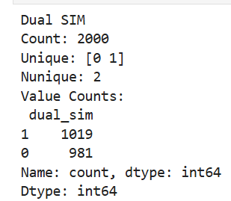
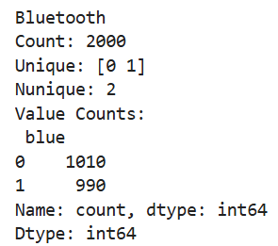
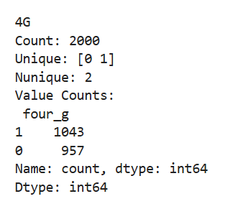
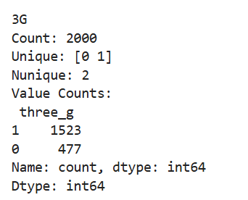
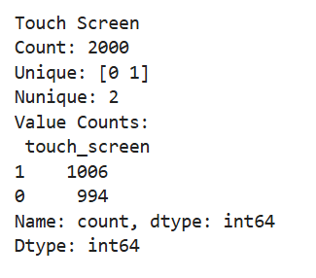
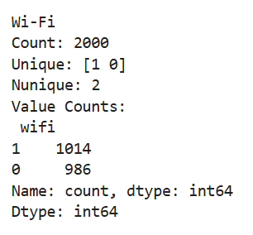
Explanation of Datasets
Categorical columns:-
Dual sim: Bluetooth:- 4G:- 3G:-
WI-FI:- Touch Screen:-
www.sivaacademy.net

Slide 4
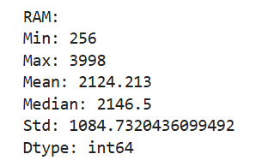
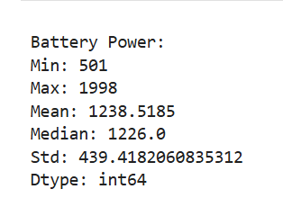
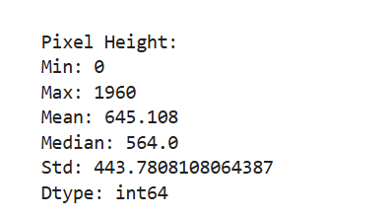
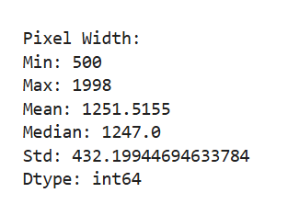
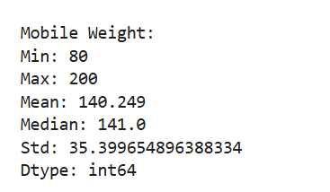
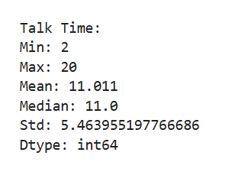
Explanation of Datasets
Numerical column:-
Ram:- Battery Power:- Pixel Height:- Pixel Width:-
Mobile Weight:- Talk Time:-
www.sivaacademy.net

Slide 5
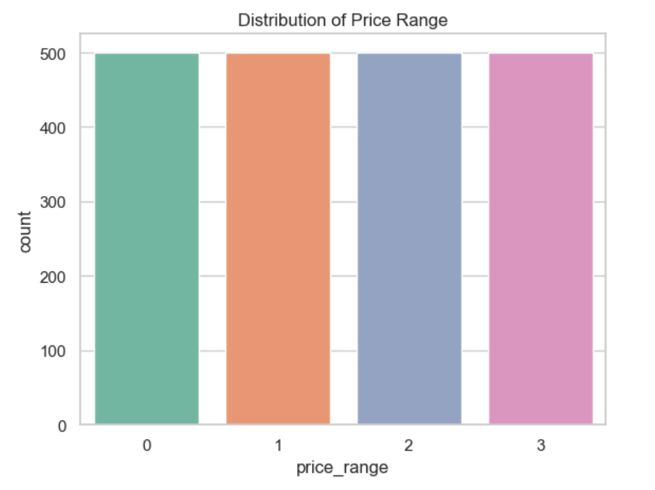
Target Variable Distribution
The bar chart shows the distribution of mobile phones across the four price categories (0, 1, 2, 3).
Each bar represents one category of price_range.
The count for each category is around 500 phones, showing that the dataset is perfectly balanced.
Balanced data is important because it ensures the classification model will not be biased toward any single price category.
The four categories can be interpreted as:
0 → Low Cost phones (basic entry-level models)
1 → Medium Cost phones (mid-range models)
2 → High Cost phones (premium models)
3 → Very High Cost phones (flagship or advanced models)
www.sivaacademy.net

Slide 6
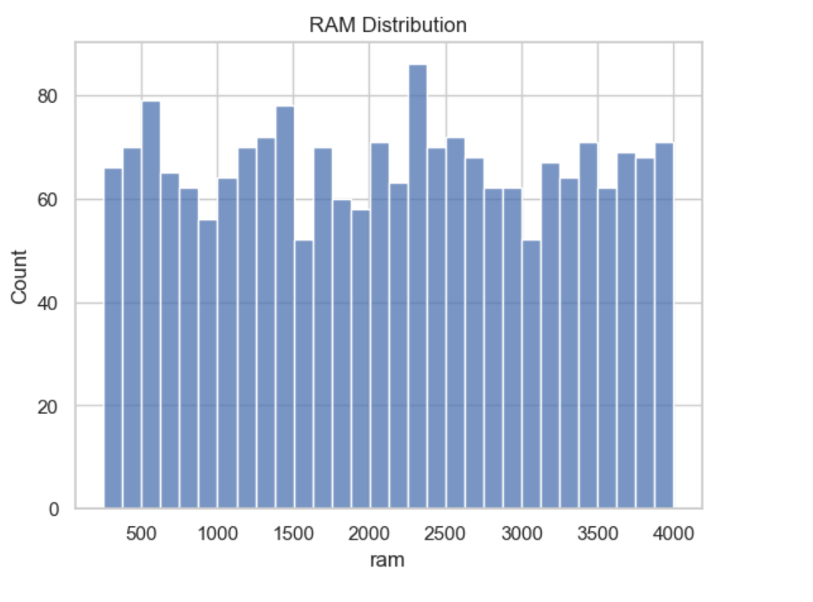
Univariate Analysis –Ram
Mobile phones in the dataset have a wide range of battery power, which means companies design phones with both small and large batteries.
Most phones fall in the middle range of battery capacity, showing that brands usually balance performance and cost.
Very high battery power is available, but only in a smaller number of phones, often in premium models.
Battery size does affect the price range, but compared to RAM, its influence on price is not very strong.
www.sivaacademy.net

Slide 7
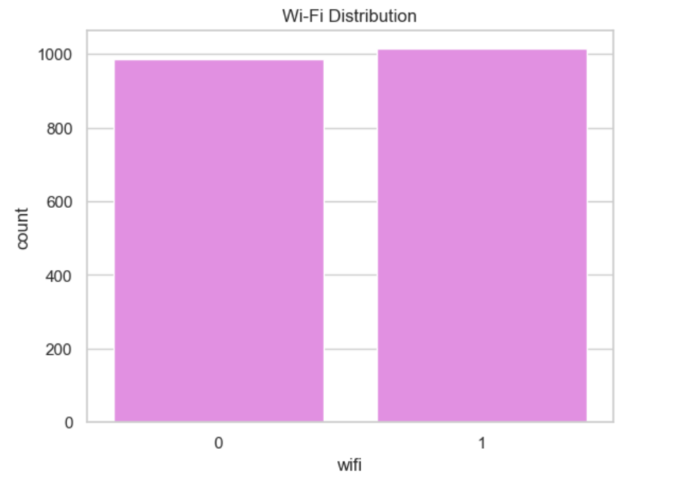
Wi-Fi
.
The dataset shows that a majority of mobile phones come with Wi-Fi support, which is now a basic and expected feature.
A smaller portion of mobiles do not have Wi-Fi, usually belonging to low-cost or older models.
This highlights that Wi-Fi is a key selling feature for modern smartphones.
The presence of Wi-Fi increases the usability of the phone, making it more attractive to customers.
www.sivaacademy.net

Slide 8
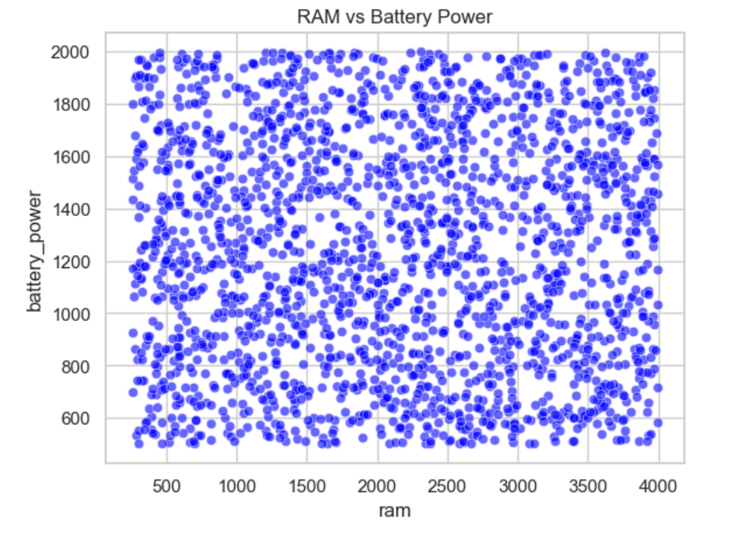
Bivariate Analysis
Numerical vs Numerical:-
RAM vs Battery Power:-
The scatterplot shows that RAM and battery power are not strongly related — phones with both low and high RAM can have varied battery sizes.
High RAM values are mostly seen in mid to high-end phones, but their battery capacity still ranges widely.
Phones with low RAM (≤ 2000 MB) are spread across all battery capacities, showing that budget phones may still offer good battery.
This suggests that manufacturers focus separately on performance (RAM) and battery life, depending on the target market.
www.sivaacademy.net

Slide 9
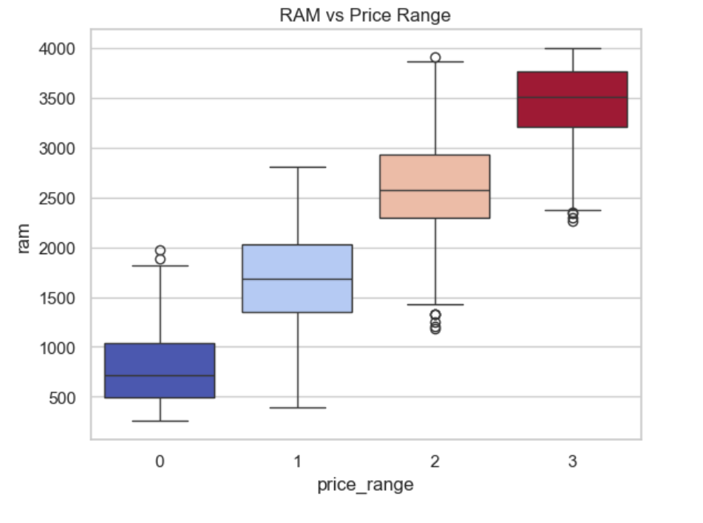
Numerical vs Categorical
RAM vs Price Range:-
Phones with low price range mostly have lower RAM, showing limited performance in budget models
As the price range increases, the median RAM value also increases, meaning higher-priced phones come with more memory.
High-end phones show wider spread in RAM, but their minimum RAM is still higher than budget phones.
This confirms that RAM is a strong factor influencing price range, with premium models offering significantly higher RAM.
www.sivaacademy.net

Slide 10
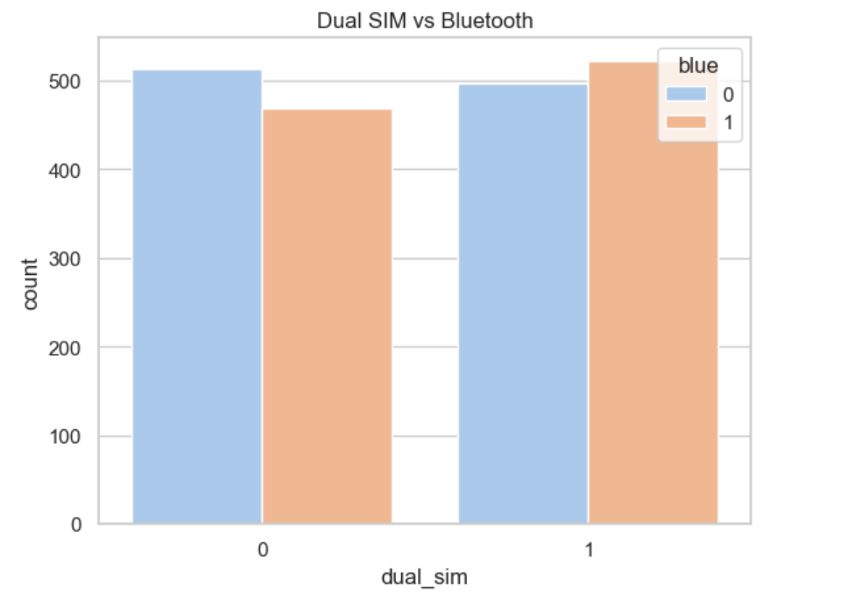
Categorical vs Categorical
Most phones in the dataset support Bluetooth, whether they have a single SIM or dual SIM option
The presence of Dual SIM does not strongly affect Bluetooth availability, as both single and dual SIM phones show similar Bluetooth adoption.
This suggests that Bluetooth is a standard feature across smartphones, independent of SIM configuration.
Dual SIM and Bluetooth are more about user convenience rather than direct factors that decide the price range of phones.
www.sivaacademy.net

Slide 11
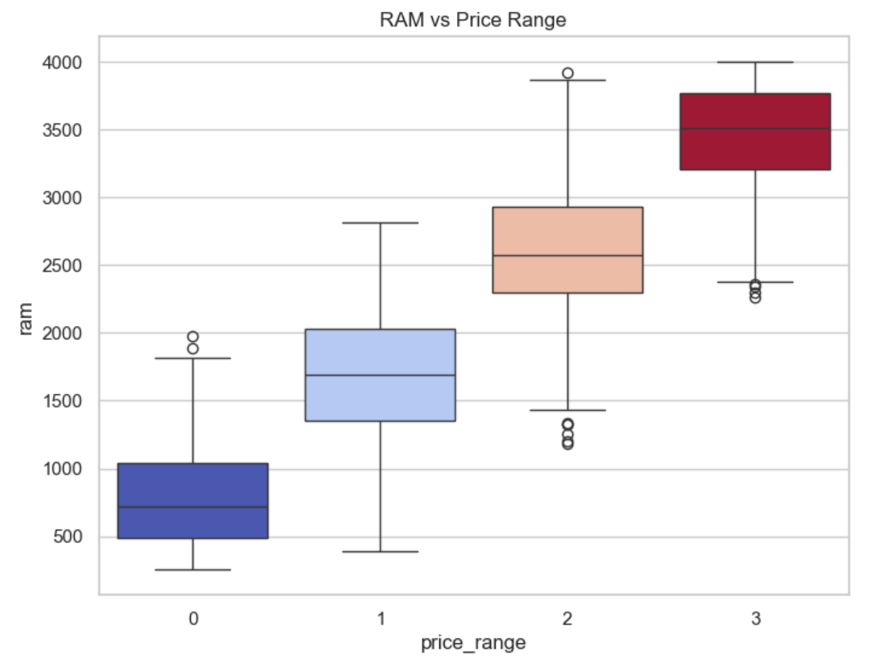
Target vs Feature analysis:
Ram Vs Price Range:-
Phones with low RAM are mostly in the low and medium price ranges.
As the price range increases, RAM also increases significantly, showing a clear positive relation.
High-end and very high-end phones almost always have large RAM capacity.
This makes RAM one of the strongest indicators of phone pricing in the dataset.
www.sivaacademy.net

Slide 12
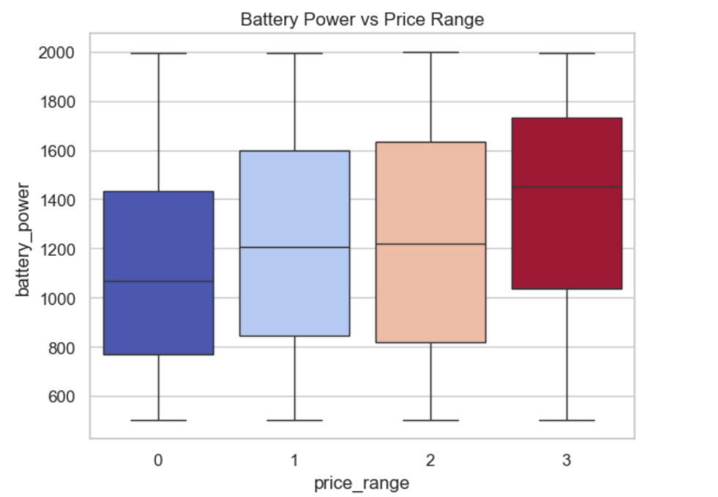
Battery Power vs Price Range
Lower price range phones usually come with smaller battery capacity.
As the price range increases, phones tend to have higher battery power.
High and very high price range phones show a wider spread, meaning they offer both mid to very large batteries.
Battery power is an important feature that influences pricing, but it’s not the only deciding factor
www.sivaacademy.net

Slide 13
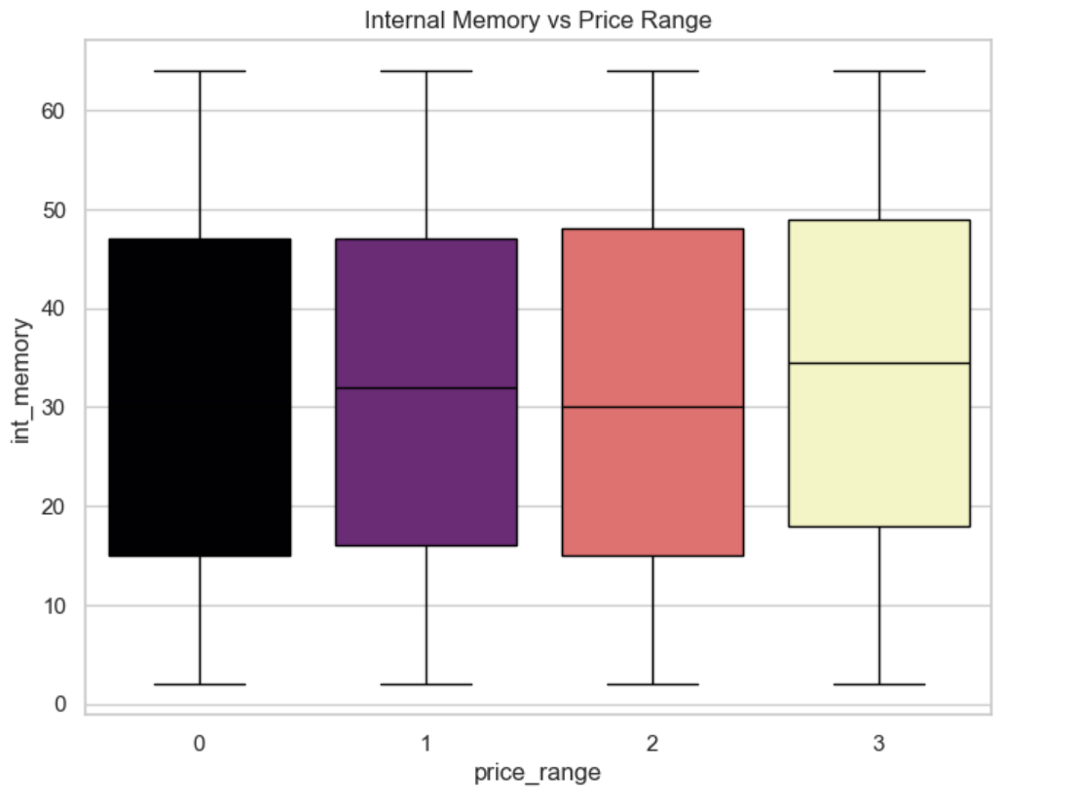
Internal Memory vs Price Range
Low price range phones generally have less internal memory, making them suitable only for basic use.
Medium price range phones show an increase in storage, targeting users who need more apps and files.
High and very high price range phones provide much larger internal memory, offering better performance and storage capacity.
Internal memory is a key factor in pricing, as higher memory is directly linked to premium smartphones.
www.sivaacademy.net

Slide 14
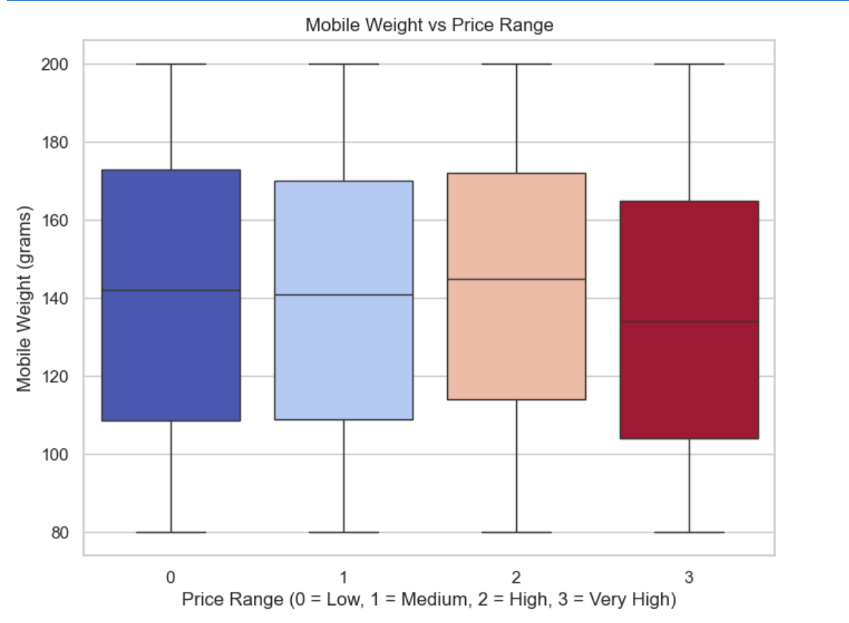
Mobile Weight vs Price Range
.
Low and medium price range phones generally show lighter weight, making them more compact and easier to carry.
High and very high price range phones tend to be heavier, possibly due to larger batteries, stronger build quality, and bigger displays.
The weight difference highlights how premium phones balance performance with durability, often at the cost of extra weight.
Mobile weight alone is not a major factor in pricing, but it often reflects the design choices and hardware quality of the device.
www.sivaacademy.net

Slide 15
INSIGHTS
RAM shows the strongest positive relationship with price range. Higher RAM directly indicates higher price segments.
Battery Power increases with price but has a wide overlap, so it’s not a decisive feature on its own.
Internal Memory contributes to price differences but overlaps across categories.
Mobile Weight has little to no impact on price classification.
Categorical features like Wi-Fi, Bluetooth, and Dual SIM are common across all categories and add minimal distinction.
Correlation analysis confirms RAM as the most influential predictor, while other features show weak or moderate relationships.
www.sivaacademy.net

Slide 16

Recommendations
Focus on RAM when analyzing or building predictive models, as it is the most reliable feature.
Combine features like RAM, battery power, and internal memory to improve classification accuracy, since no single feature (except RAM) is sufficient alone.
Ignore weak predictors like mobile weight, which add little value to price classification.
Use categorical features cautiously (Wi-Fi, Bluetooth, Dual SIM), since they do not differentiate price well.
www.sivaacademy.net

Slide 17


Thank You

